Slide 1
Maths
TT Rockstars!
Literacy
Write a story using the picture attached and the key words.
Science
Option 1 - Search around your home for appliances that are battery operated, mains electricity operated or any that non-electrical. Write a list of what you have found.
Option 2 - Can you make a potato battery? Use the attached resources for instructions. Grown up help will be required and permission needed. Take photos or film your experiment and send it into the office.
History
Design and make your own Roman Army shield.
Year 4 Homework
Autumn Term One
Art
Create a mosaic collage of your choice using items you can find at home.

Slide 2
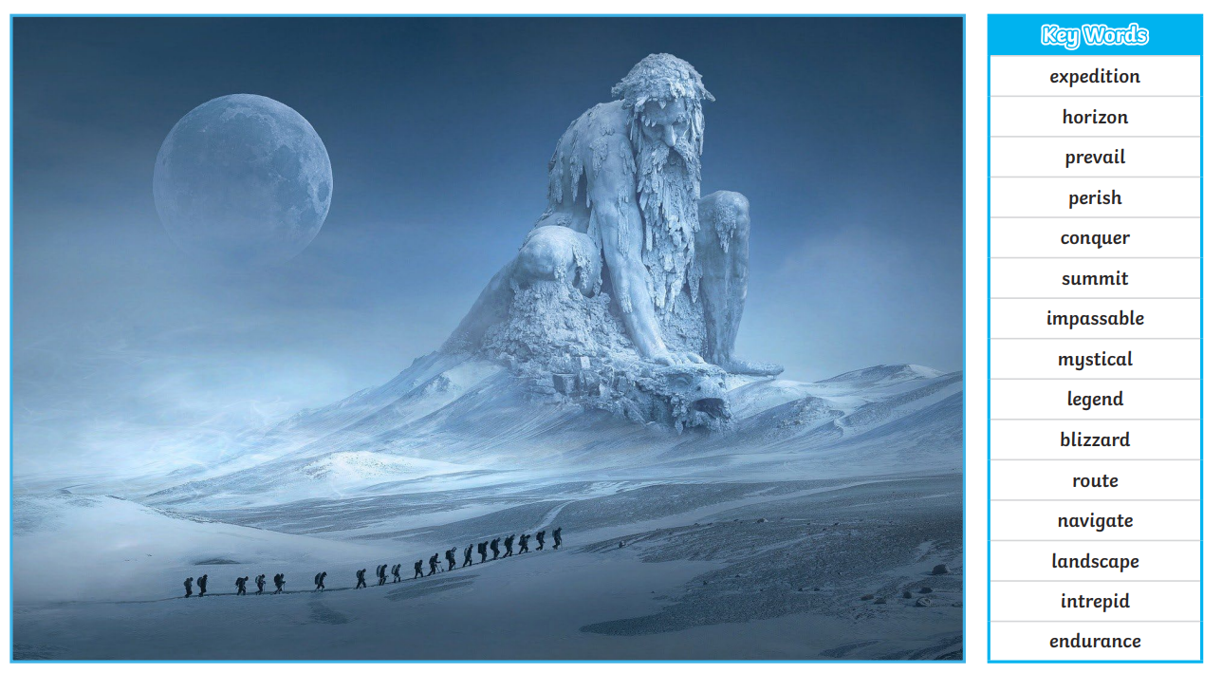

Slide 3
